Slide 1
Year 7 Knowledge Organiser
French
Term 4
Unit 1: What is your favourite school subject?
Unit 2: What do you wear?
Unit 3: Describe your school day.
Unit 4: School in France
Unit 5: What do you do after school?
Unit 6: Describe your school.

Slide 2
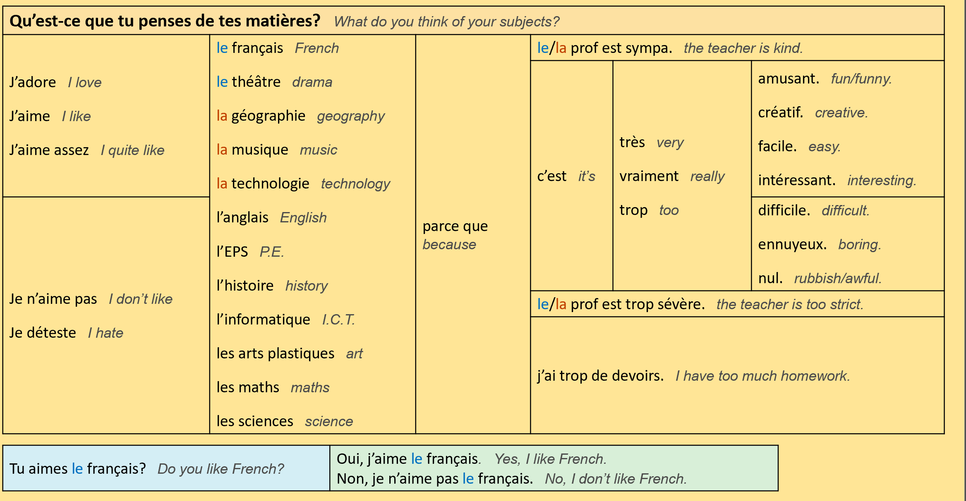
Unit 1: What is your favourite school subject? (Page 1)

Slide 3
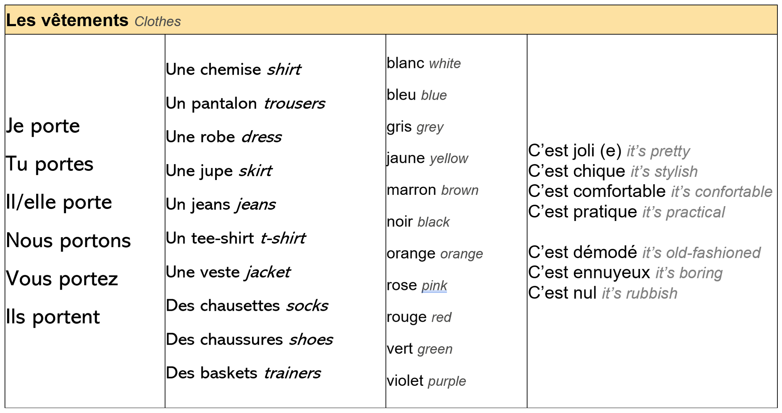
Unit 2: What do you wear? (Page 2)

Slide 4
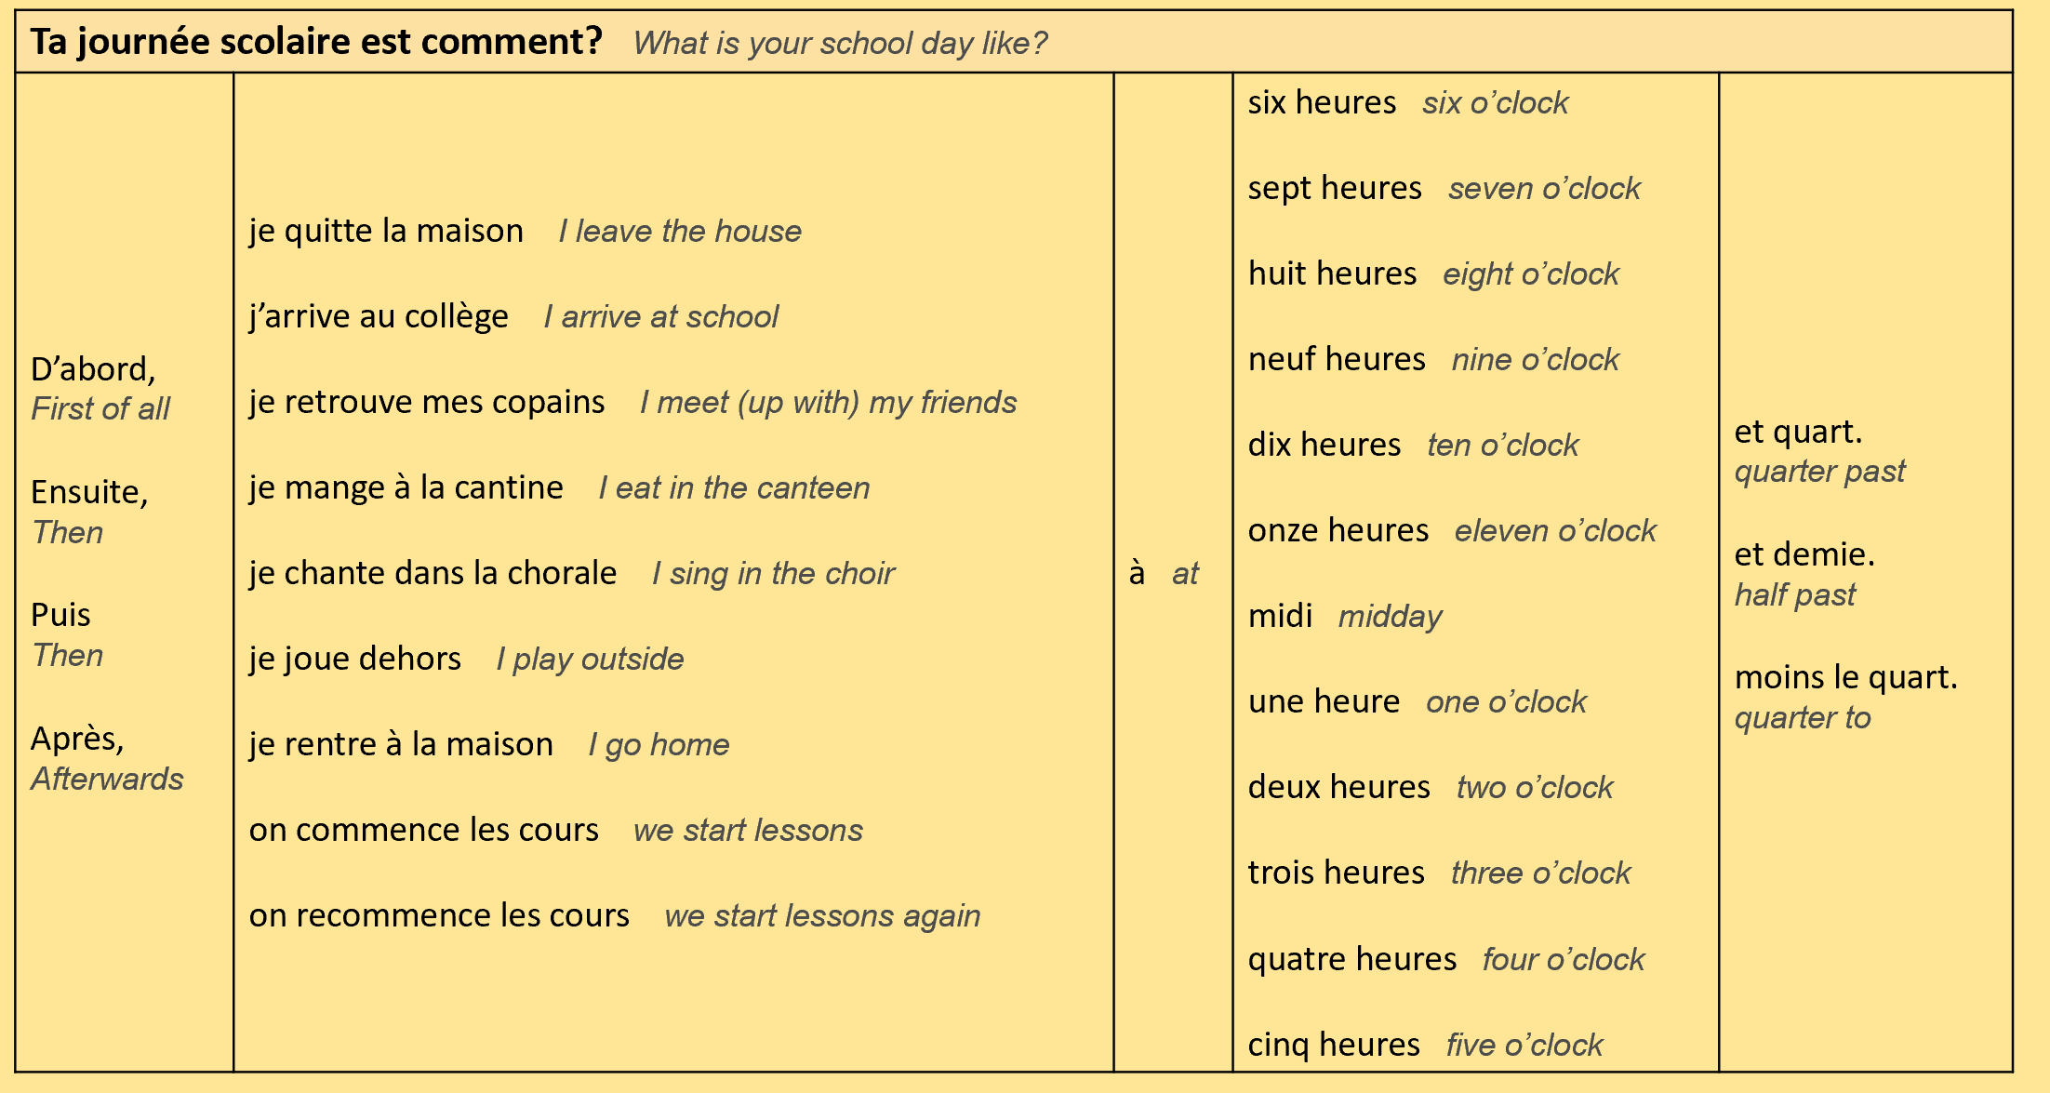
Unit 3: Describe your school day. (Page 3)

Slide 5
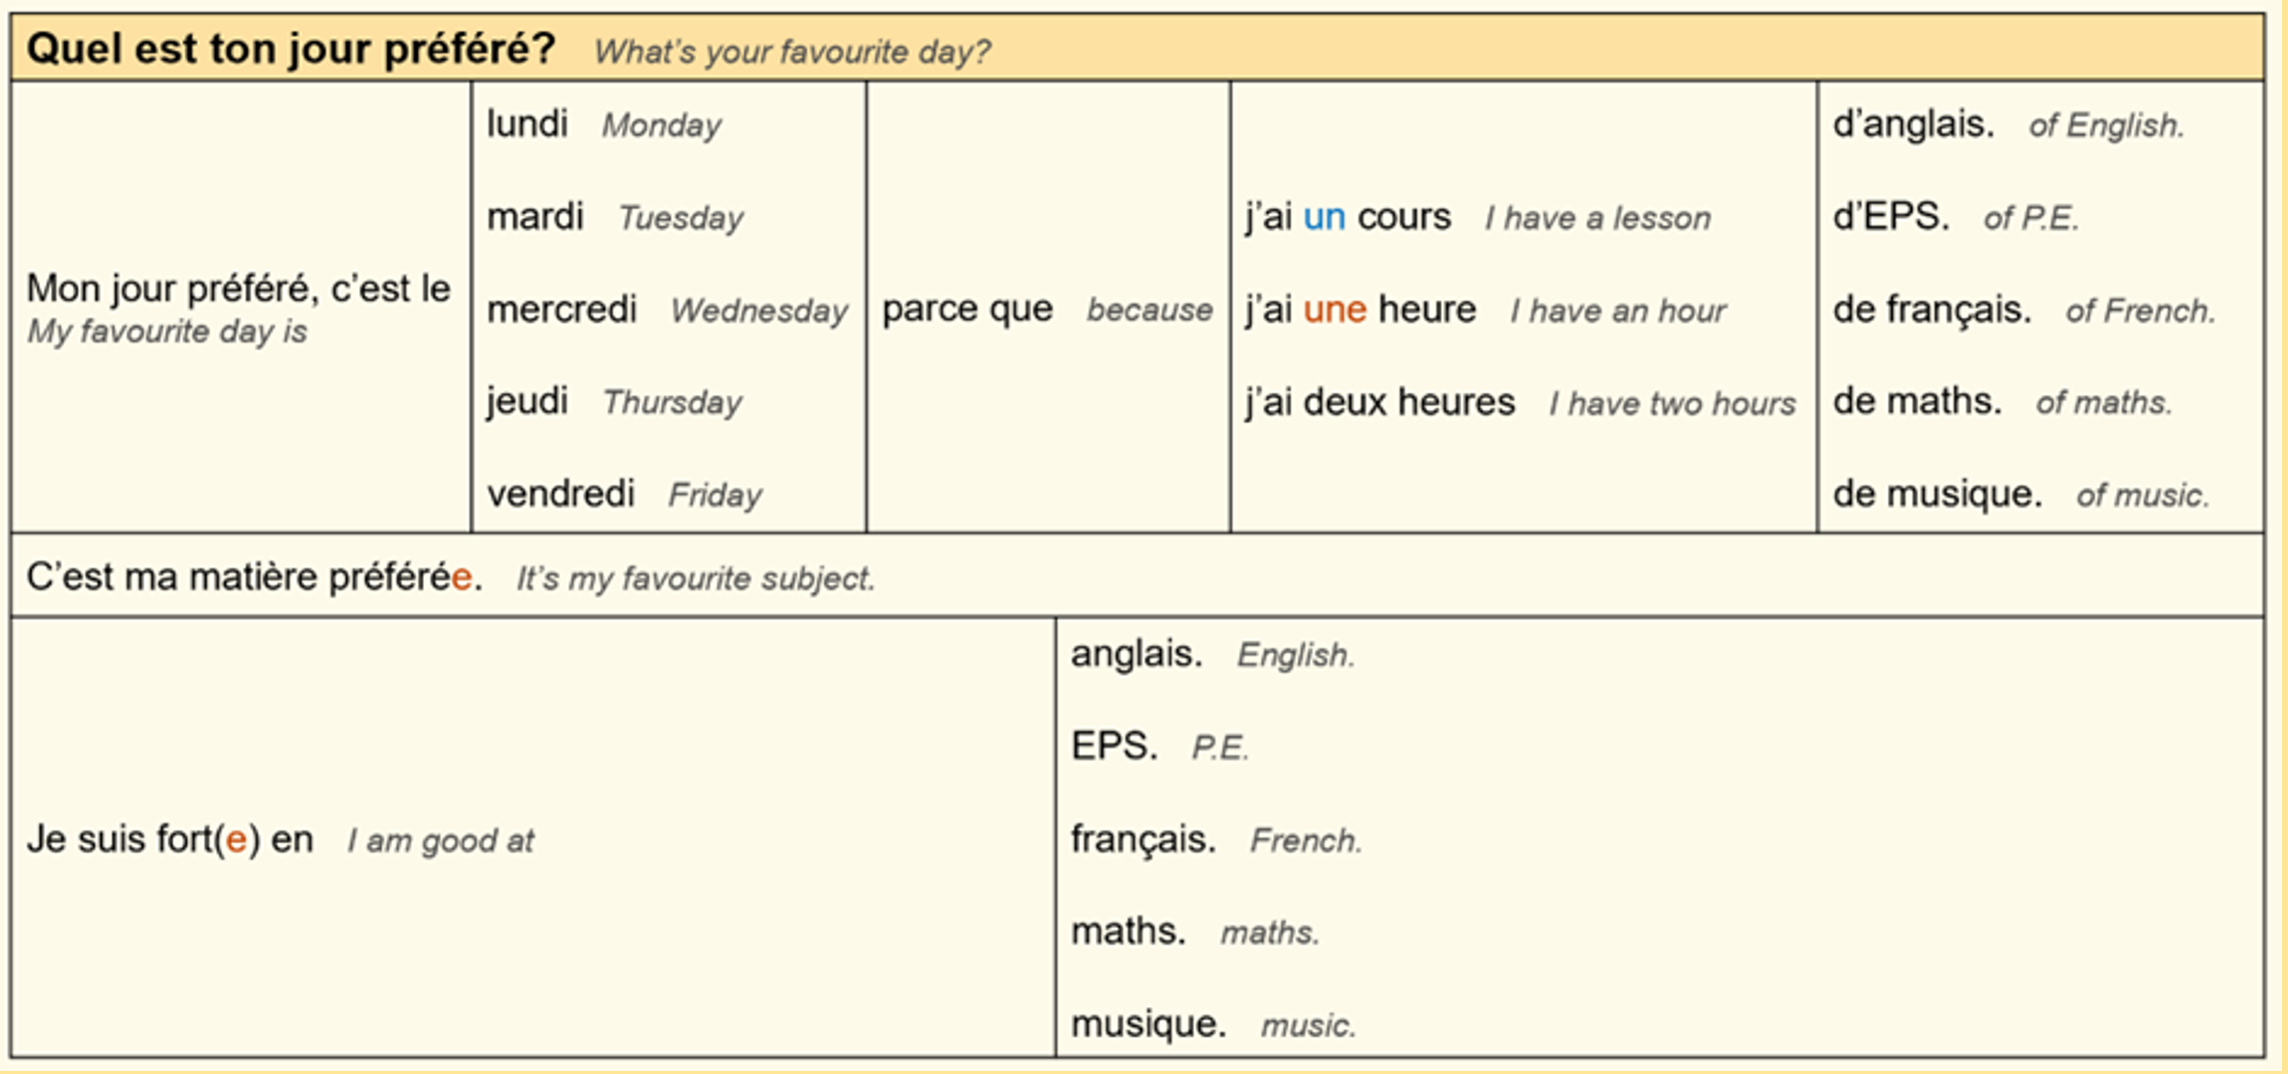
Unit 4: School in France. (Page 4)

Slide 6
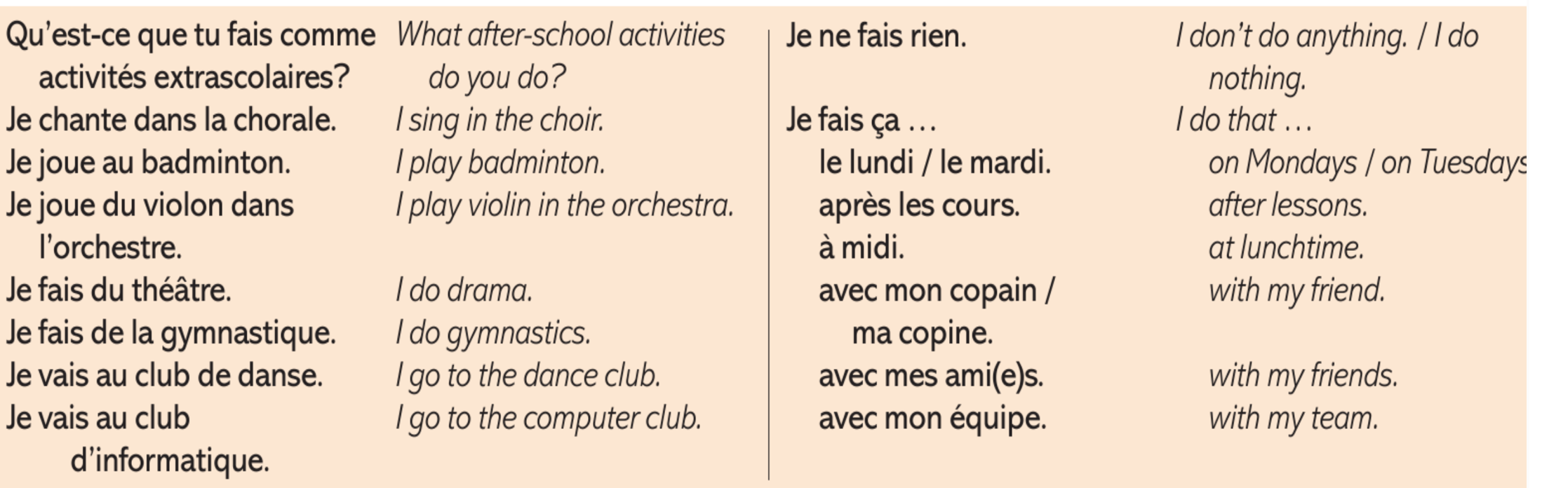
Unit 5: What do you do after school? (Page 5)

Slide 7
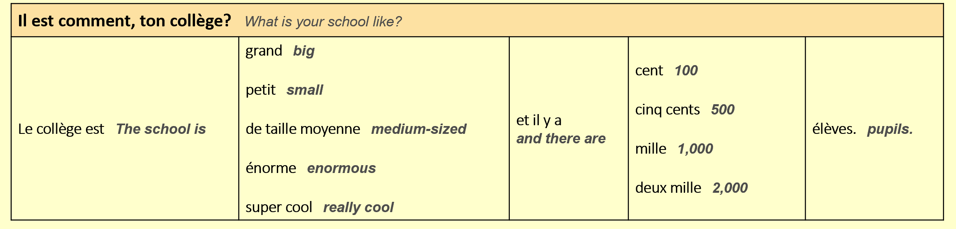
Unit 6: Describe yours school. (Page 6)

Slide 8
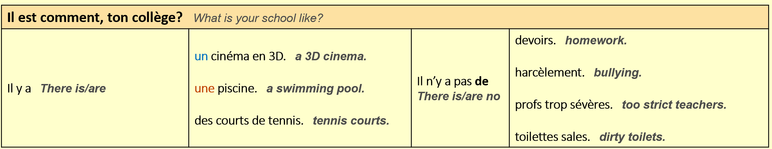
Unit 6: Describe your school. (Page 6)

